Slide 1
Shabbat Shalom
Welcome to
The Miqra
Proclaiming the Ancient Paths of Our Biblical Roots
January 23, 2021

Slide 2
Hebrews 9
The Sanctuaries and Covenants
Notes:
Colossae is located in Phrygia near Ephesus and Laodicea.

Slide 3
The Earthly Sanctuary
Hebrews 9:1-2
Now even the first [covenant] had righteous regulations of service and the earthly sanctuary. For there was a tabernacle prepared, the outer one, in which [were] the lampstand and the table and the sacred bread; this is called the holy place.
Exodus 26 describes the details of the tent – the boards, curtains, supporting ropes and poles, etc.
Exodus 25 describes the furniture in the holy places

Slide 4
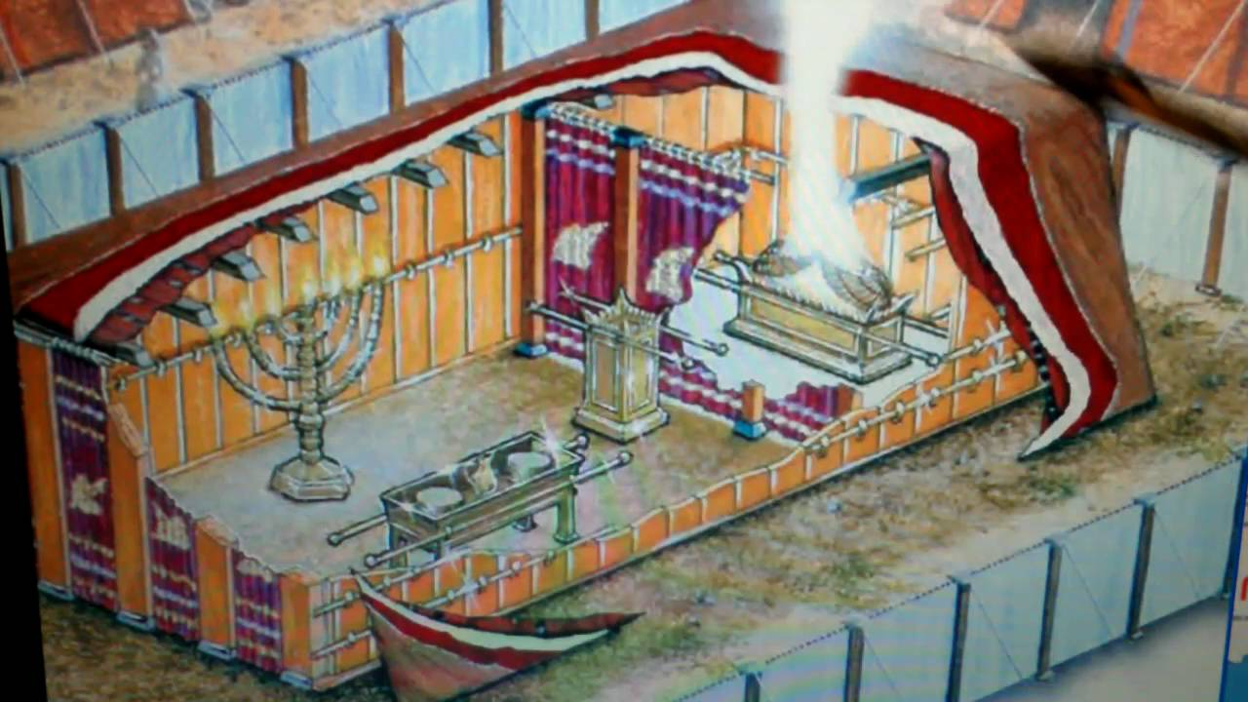
Outline of Hebrews 9

Slide 5
The Earthly Sanctuary
Hebrews 9:3-5
Behind the second veil there was a tabernacle which is called the Holy of Holies, having a golden altar of incense and the ark of the covenant covered on all sides with gold, in which was a golden jar holding the manna, and Aharon's rod which budded, and the tables of the covenant; and above it [were] the cherubim of glory overshadowing the mercy seat; but of these things we cannot now speak in detail.

Slide 6
The Sanctuary Service
Hebrews 9:6-7
Now when these things have been so prepared, the priests are continually entering the outer tabernacle performing the divine worship, but into the second, only the high priest [enters] once a year, not without [taking] blood, which he offers for himself and for the sins of the people committed in ignorance.
- Leviticus 16 Day of the Atonements

Slide 7
The Sanctuary As a Symbol
Hebrews 9:8-9a
The Holy Spirit [is] signifying this, that the way into (the way of…) the holy place has not yet been disclosed while the first tabernacle is still standing, which [is] a symbol for the present time.
- Parabole - someth. that serves as a model or example pointing beyond itself for later realization, type, figure

Slide 8
The Sanctuary Symbol
Hebrews 9:9b-10
Accordingly both gifts and sacrifices are offered which cannot make the worshiper perfect in conscience, since they [relate] only to food (Lev 11) and drink and various washings, regulations for the body imposed until a time of reformation.
- dio,rqwsij (di-or-thosis) - a process leading to a new order viewed as something yet to be realized, improvement, reformation, new order

Slide 9
The Greater Sanctuary Service
Hebrews 9:11-12
But when Messiah appeared [as] a high priest of the good things that were to come, [He entered] through the greater and more perfect tabernacle, not made with hands, that is to say, not of this creation; and not through the blood of goats and calves, but through His own blood, He entered the holy place once for all, having obtained eternal redemption.

Slide 10
Made Without Hands
Mark 14:57-59
Some stood up and [began] to give false testimony against Him, saying, "We heard Him say, 'I will destroy this temple made with hands, and in three days I will build another made without hands.'" Not even in this respect was their testimony consistent.
4th Gospel points out that he was speaking of his body
Steven said no structure could hold Elohim

Slide 11
The Cleansings Compared
Hebrews 9:13-14
For if the blood of goats and bulls and the ashes of a heifer sprinkling those who have been defiled sanctify for the cleansing of the flesh, how much more will the blood of Messiah, who through the eternal Spirit offered Himself without blemish to Elohim, cleanse your conscience from dead works to serve the living Elohim?
- 6:1 “repentance from dead works”

Slide 12
The Cleansing of Sin
Hebrews 9:15
For this reason He is the mediator of a new covenant, so that, since a death has taken place for the redemption of the transgressions that were [committed] under the first covenant, those who have been called may receive the promise of the eternal inheritance.

Slide 13
The Death of the Covenant Maker?
Hebrews 9:16-18
For where a covenant is, there must of necessity be the death of the one who made it. For a covenant is valid [only] when men are dead, for it is never in force while the one who made it lives. Therefore even the first [covenant] was not inaugurated without blood.

Slide 14
The Formal Arrangement of the Covenant
diati,qhmi (dia-tith-emee)
to make formal arrangements for someth. to be done or brought about, decree, ordain
In verses 16 and 17

Slide 15
A Better Translation
Hebrews 9:16-18
For where a covenant is, there must of necessity be a death according to its (the covenant’s) arrangement. For a covenant is confirmed by reason of the dead ones, since it is never in force while the confirming one (i.e. the sacrifice) lives. Therefore even the first [covenant] was not inaugurated without blood.
- Any covenant must be accompanied by a blood sacrifice. It is not confirmed until the sacrifice dies.

Slide 16
An Example of the Required Death
Hebrews 9:19-20
For when every commandment had been spoken by Mosheh to all the people according to the Law, he took the blood of the calves and the goats, with water and scarlet wool and hyssop, and sprinkled both the book itself and all the people, saying, "THIS IS THE BLOOD OF THE COVENANT WHICH ELOHIM COMMANDED YOU."

Slide 17
The Cleansing Blood
Hebrews 9:21-22
And in the same way he sprinkled both the tabernacle and all the vessels of the ministry with the blood. And according to the Law, [one may] almost [say], all things are cleansed with blood, and without shedding of blood there is no forgiveness.
1. the act of freeing and liberating from someth. that confines, release
2. the act of freeing from an obligation, guilt, or punishment, pardon, cancellation

Slide 18
Messiah’s Cleansing
Hebrews 9:23
Therefore it was necessary for the copies of the things in the heavens to be cleansed with these, but the heavenly things themselves with better sacrifices than these.
- Messiah’s sacrifice is a Better Sacrifice

Slide 19
The Cleansing of the Heavenly Sanctuary
Hebrews 9:24-26
For Messiah did not enter a holy place made with hands, a [mere] copy of the true one, but into heaven itself, now to appear in the presence of Elohim for us; nor was it that He would offer Himself often, as the high priest enters the holy place year by year with blood that is not his own. Otherwise, He would have needed to suffer often since the foundation of the world; but now once at the consummation of the ages He has been manifested to put away sin by the sacrifice of Himself.

Slide 20
The Cleansing Blood
Hebrews 9:27-28
And inasmuch as it is appointed for men to die once and after this [comes] judgment, so Messiah also, having been offered once to bear the sins of many, will appear a second time for salvation without [reference to] sin, to those who eagerly await Him.

Slide 21
Messiah Bears Our Sin
Isaiah 53:12
Therefore, I will allot Him a portion with the great, And He will divide the booty with the strong; Because He poured out Himself to death, And was numbered with the transgressors; Yet He Himself bore the sin of many, And interceded for the transgressors.

Slide 22
Summary of Hebrews 9
The earthly sanctuary was only temporary
Messiah entered the heavenly sanctuary
Messiah’s death was a one time sacrifice
Messiah’s Sacrifice is a better sacrifice

Slide 23
You Can Get More Information About Many Other Bible Study Topics From a Hebraic Perspective At My Website:
www.BibleTruth.cc

