Slide 1
Shabbat Shalom
Welcome to
The Miqra
Proclaiming the Ancient Paths of Our Biblical Roots
October 10, 2020

Slide 2
Colossians 1:1-14
Walking in a Manner Worthy of the Lord
Notes:
Colossae is located in Phrygia near Ephesus and Laodicea.

Slide 3
Greetings to the Colossians
Colossians 1:1-2
Paul, an apostle of Yahusha Messiah by the will of Elohim, and Timothy our brother, To the saints and faithful brethren in Messiah at Colossae: Grace to you and peace from Elohim our Father.

Slide 4
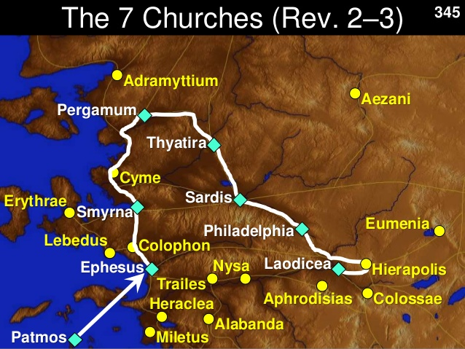

Slide 5
Reasons For Writing Letters
Stay in contact
Correct behavioral issues
Correct doctrinal issues
Present sound doctrine
Lay out travel plans
Warn against false teachers

Slide 6
The Occasion of this Letter
A false teaching had emerged in Colossae
Paul does not discuss the nature of this teaching except in the correct teaching he expresses about the person of Messiah and his connection to the Father
Likely, the false teachers, as in almost everywhere else, are Jewish cynics, denying the deity of Yahusha
At the heart of the false teachings are the traditions with regard to new moon and Sabbath, which are rooted in the commandments of men (see chpt 2)

Slide 7
Thanks for the Colossians
Colossians 1:3-5
We give thanks to Elohim, the Father of our Lord Yahusha Messiah, praying always for you, since we heard of your faith in Messiah Yahusha and the love which you have for all the saints; because of the hope laid up for you in heaven, of which you previously heard in the word of truth, the gospel…

Slide 8
Love for the Brotheres
Note: faith in Messiah, love for the brethren
1 John 4:19-21 We love, because He first loved us. If someone says, "I love Elohim," and hates his brother, he is a liar; for the one who does not love his brother whom he has seen, cannot love Elohim whom he has not seen. And this commandment we have from Him, that the one who loves Elohim should love his brother also.

Slide 9
What is this Hope?
The faith (faithfulness) and love of the believers is rooted in the “hope laid up for you in heaven”
This hope is NOT about going to heaven or “mansions” built in heaven for Christians
– an obvious reference to Messiah who has ascended into heaven

Slide 10
The Gospel Going Worldwide
Colossians 1:6-7
…which has come to you, just as in all the world also it is constantly bearing fruit and increasing, even as in you also since the day you heard and understood the grace of Elohim in truth;
Truth bears good fruit such as love and peace – fruit of the Spirit
Fruit of righteous is the living out of what is right, obedience to Yah’s instructions

Slide 11
Error Bears Poisonous Fruit
Deuteronomy 29:17-18
…moreover, you have seen their abominations and their idols [of] wood, stone, silver, and gold, which [they had] with them); so that there will not be among you a man or woman, or family or tribe, whose heart turns away today from Yahuwah our Elohim, to go and serve the gods of those nations; that there will not be among you a root bearing poisonous fruit and wormwood.

Slide 12
The Gospel Must Be Proclaimed by Someone
Colossians 1:8
…just as you learned from Epaphras, our beloved fellow bond-servant, who is a faithful servant of Messiah on our behalf, and he also informed us of your love in the Spirit.
- Just as in his letter to the Philippians, Timothy and Epaphras (Epaphroditus) are instrumental partners of Paul in bringing this message of truth to all the regions of Turkey

Slide 13
Walking Worthy
Colossians 1:9-10
For this reason also, since the day we heard [of it], we have not ceased to pray for you and to ask that you may be filled with the knowledge of His will in all spiritual wisdom and understanding, so that you will walk in a manner worthy of the Lord, to please [Him] in all respects, bearing fruit in every good work and increasing in the knowledge of Elohim;

Slide 14
The Knowledge of His Will
1 John 2:15-17 Do not love the world nor the things in the world. If anyone loves the world, the love of the Father is not in him. For all that is in the world, the lust of the flesh and the lust of the eyes and the boastful pride of life, is not from the Father, but is from the world. The world is passing away, and [also] its lusts; but the one who does the will of Elohim lives forever.

Slide 15
What is the Will of Elohim?
1 Thessalonians 4:3-7 For this is the will of Elohim, your sanctification; [that is], that you abstain from sexual immorality; that each of you know how to possess his own vessel in sanctification and honor, not in lustful passion, like the Gentiles who do not know Elohim; [and] that no man transgresses and defrauds his brother in the matter because the Lord is [the] avenger in all these things, just as we also told you before and solemnly warned [you]. For Elohim has not called us for the purpose of impurity, but in sanctification.

Slide 16
The Knowledge of Elohim?
Getting to know Elohim – who he is, his characteristics, his will, his thoughts, his heart, what he loves and what he hates, his power and authority, his sovereignty, his love, his plan for humanity

Slide 17
Qualifying Us to Reward
Colossians 1:11-12
…empowered with all power, according to His glorious might, for the attaining of all perseverance and long-suffering; joyously giving thanks to the Father, who has qualified us to share in the inheritance of the saints in Light.
-Qualify - to cause to be adequate, make sufficient
Elohim empowers us to qualify for the inheritance

Slide 18
What Qualifies Us to Share the Inheritance?
Obedience, aligning ourselves to his will
Faithfulness as Abraham fulfilled by his obedience to Elohim’s instruction about offering Isaac

Slide 19
What Qualifies Us to Share the Inheritance?
Hebrews 11:8-10 By faith Abraham, when he was called, obeyed by going out to a place which he was to receive for an inheritance; and he went out, not knowing where he was going. By faith he lived as an alien in the land of promise, as in a foreign [land], dwelling in tents with Yitzchak and Ya'acob, fellow heirs of the same promise; for he was looking for the city which has foundations, whose architect and builder is Elohim.

Slide 20
What Qualifies Us to Share the Inheritance?
Hebrews 11:17-19
By faith Abraham, when he was tested, offered up Yitzchak, and he who had received the promises was offering up his only begotten [son]; [it was he] to whom it was said, "IN ISAAC YOUR DESCENDANTS SHALL BE CALLED." He considered that Elohim is able to raise [people] even from the dead, from which he also received him back as a type.

Slide 21
What Qualifies Us to Share the Inheritance?
James 2:21-23
Was not Abraham our father justified by works when he offered up Yitzchak his son on the altar? You see that faith was working with his works, and as a result of the works, faith was perfected; and the Scripture was fulfilled which says, "AND ABRAHAM BELIEVED GOD, AND IT WAS RECKONED TO HIM AS RIGHTEOUSNESS," and he was called the friend of Elohim.

Slide 22
Greetings to the Colossians
Colossians 1:13-14
For He rescued us from the domain (authority, jurisdiction) of darkness, and transferred (removed) us to the kingdom (domain, rule) of His beloved Son, in whom we have redemption, the forgiveness of sins.

Slide 23
Redemption
1. release from a painful interrogation, release, Hb 11:35 from torture. Some were not released from torture…
2. release from a captive condition, release, redemption, deliverance fig. ext. of the orig. use in connection with manumission of captives or slaves: the release fr. sin and finiteness that comes through Christ.

Slide 24
Summary of Colossians 1:1-14
Let’s give thanks and pray for each other
The message of the gospel bears fruit wherever it is taken
We are to gain a knowledge of Elohim and of his will through his word
The will of Elohim is for us to obey his commands
Through his word, he empowers us to qualify for the promised inheritance given to Abraham and his seed

Slide 25
You Can Get More Information About Many Other Bible Study Topics From a Hebraic Perspective At My Website:
www.BibleTruth.cc

