Slide 1
Shabbat Shalom
&
Chag Sameach
Welcome to
The Miqra
Proclaiming the Ancient Paths
of Our Biblical Roots
April 3, 2021

Slide 2
Deliverance, Pt 4
Through the Sea of Reeds
Notes:
Colossae is located in Phrygia near Ephesus and Laodicea.

Slide 3
The Journey Out of Mitzrayim
Shemot/Exodus 13:17-18
Now when Pharaoh had let the people go, Elohim did not lead them by the way of the land of the Philistines, even though it was near; for Elohim said, "The people might change their minds when they see war, and return to Mitzrayim." Hence Elohim led the people around by the way of the wilderness to the Sea of Reeds (Yam Suph); and the sons of Israel went up in martial array (“by fifties”) from the land of Mitzrayim.

Slide 4
The Journey Out of Mitzrayim
Shemot/Exodus 13:19-20
Mosheh took the bones of Yoseph with him, for he had made the sons of Israel solemnly swear, saying, "Elohim will surely take care of you, and you shall carry my bones from here with you." Then they set out from Succoth and camped in Etham on the edge of the wilderness.

Slide 5
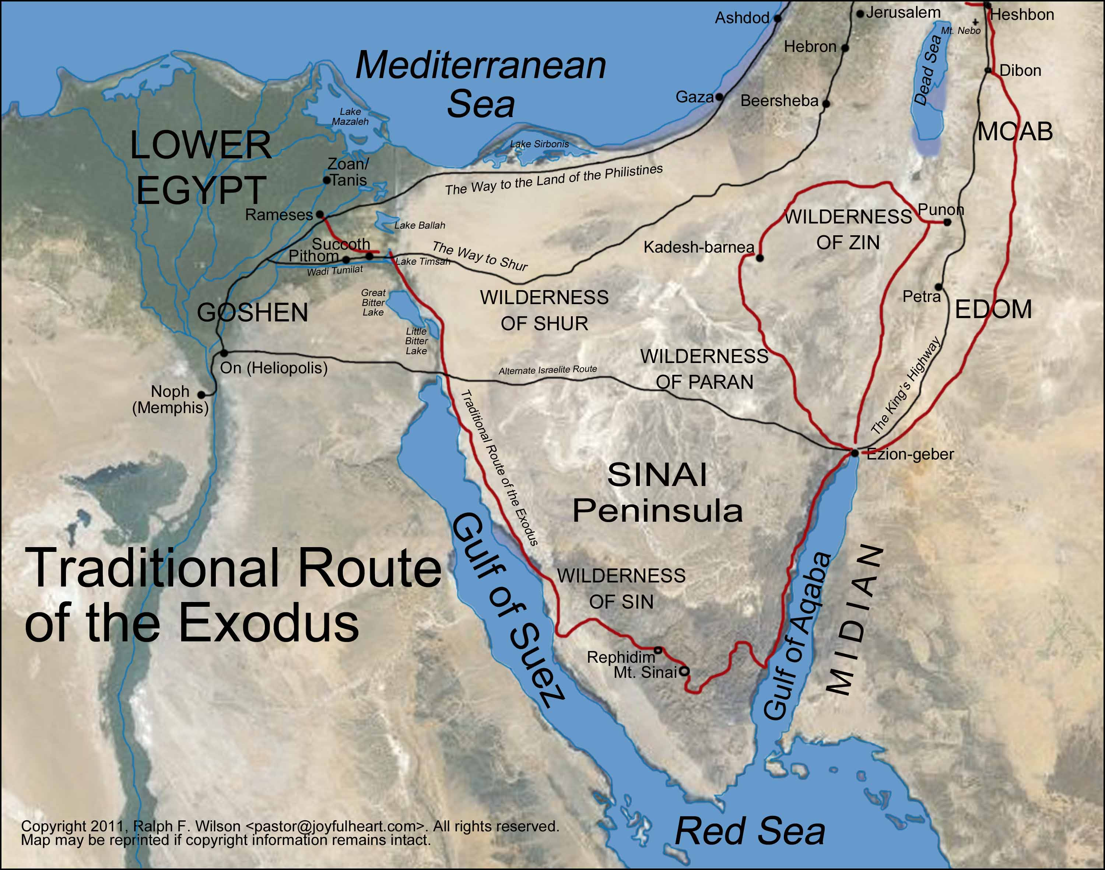

Slide 6
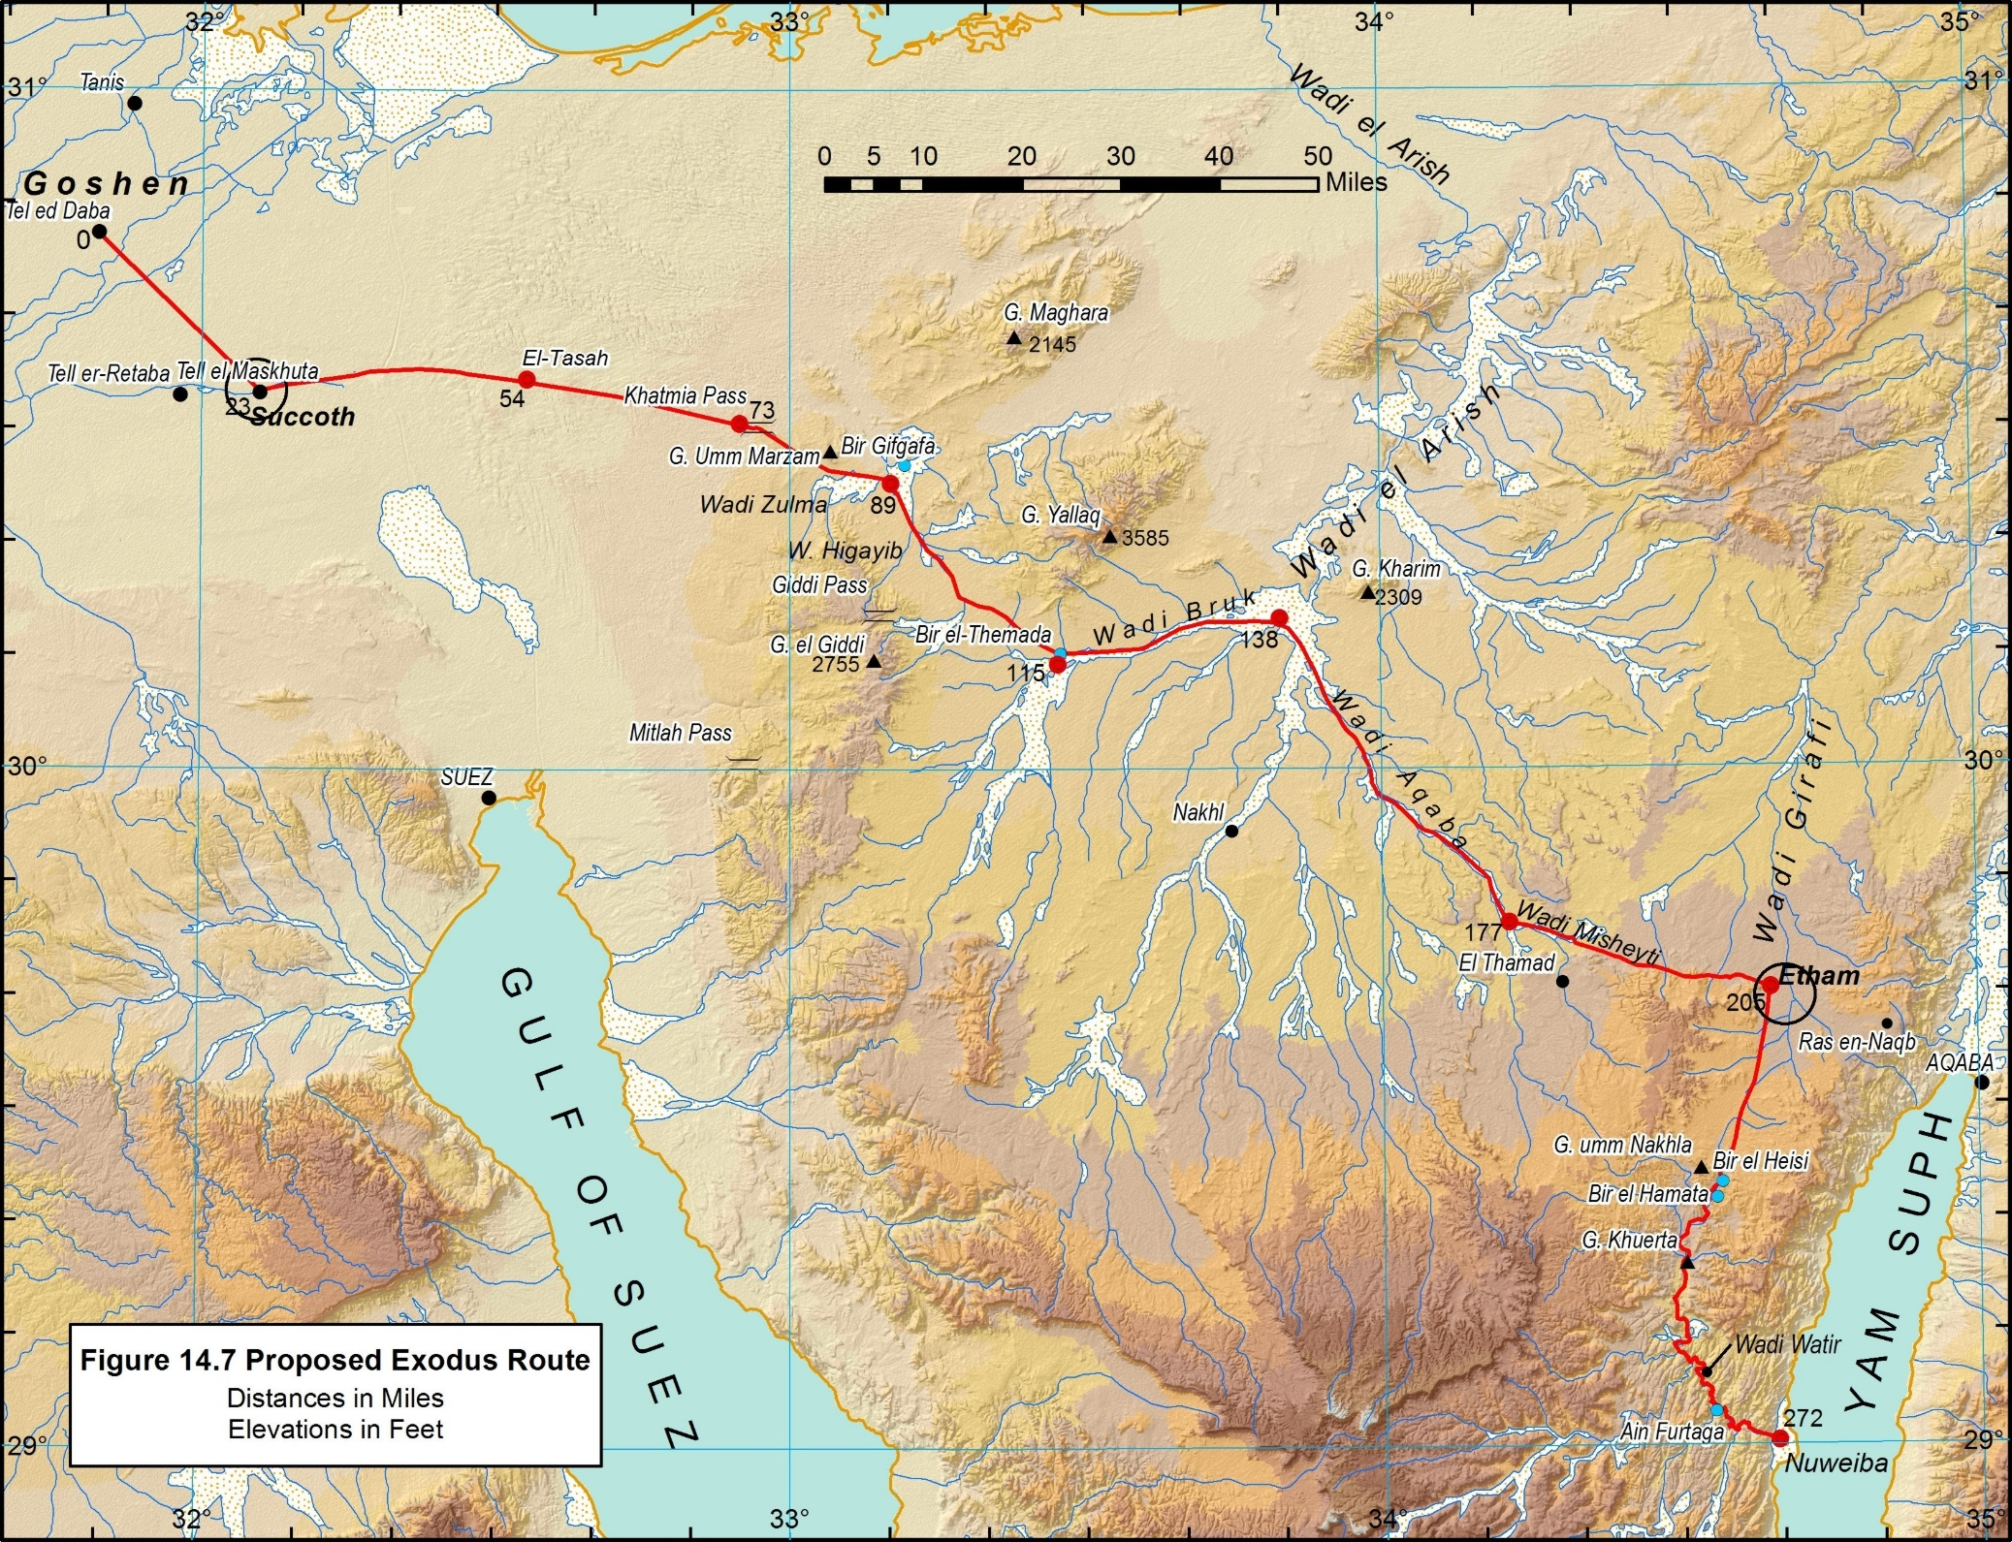

Slide 7
The Journey Out of Mitzrayim
Shemot/Exodus 13:21-22
Yahuwah was going before them in a pillar of cloud by day to lead them on the way, and in a pillar of fire by night to give them light, that they might travel by day and by night. He did not take away the pillar of cloud by day, nor the pillar of fire by night, from before the people.

Slide 8
The Camp By the Sea
Shemot/Exodus 14:1-3
Now Yahuwah spoke to Mosheh, saying, "Tell the sons of Israel to turn and camp before Pi-hahiroth, between Migdol and the sea; you shall camp in front of Baal-zephon, opposite it, by the sea. For Pharaoh will say of the sons of Israel, 'They are wandering aimlessly in the land; the wilderness has shut them in.'

Slide 9
“Harden”
Vs 4 Thus I will harden Pharaoh's heart,
qz:x' (chazak) vb. Be or grow firm, strong, strengthen;
be(come) strong, strengthen, prevail, harden, be courageous, be sore
Yehoshua 1:6-7 "Be strong and courageous, for you shall give this people possession of the land which I swore to their fathers to give them. Only be strong and very courageous;

Slide 10
The Journey Out of Mitzrayim
Shemot/Exodus 14:4-5
Thus I will harden Pharaoh's heart, and he will chase after them; and I will be honored through Pharaoh and all his army, and the Mitzrayim will know that I am Yahuwah." And they did so. When the king of Mitzrayim was told that the people had fled, Pharaoh and his servants had a change of heart toward the people, and they said, "What is this we have done, that we have let Israel go from serving us?"

Slide 11
Pharaoh Pursues Israel
Shemot/Exodus 14:6-8
So he made his chariot ready and took his people with him; and he took six hundred select chariots, and all the [other] chariots of Mitzrayim with officers over all of them. Yahuwah hardened the heart of Pharaoh, king of Mitzrayim, and he chased after the sons of Israel as the sons of Israel were going out boldly.

Slide 12
The Journey Out of Mitzrayim
Shemot/Exodus 14:9-10
Then the Mitzrayim chased after them [with] all the horses [and] chariots of Pharaoh, his horsemen and his army, and they overtook them camping by the sea, beside Pi-hahiroth, in front of Baal-zephon. As Pharaoh drew near, the sons of Israel looked, and behold, the Mitzrayim were marching after them, and they became very frightened; so the sons of Israel cried out to Yahuwah.

Slide 13
Sons of Israel Doubt
Shemot/Exodus 14:11-12
Then they said to Mosheh, "Is it because there were no graves in Mitzrayim that you have taken us away to die in the wilderness? Why have you dealt with us in this way, bringing us out of Mitzrayim? Is this not the word that we spoke to you in Mitzrayim, saying, 'Leave us alone that we may serve the Mitzrayim '? For it would have been better for us to serve the Mitzrayim than to die in the wilderness."

Slide 14
Yahuwah Will Fight For You
Shemot/Exodus 14:13-15
But Mosheh said to the people, "Do not fear! Stand by and see the deliverance of Yahuwah which He will accomplish for you today; for the Mitzrayim whom you have seen today, you will never see them again forever. "Yahuwah will fight for you while you keep silent.” Then Yahuwah said to Mosheh, "Why are you crying out to me? Tell the sons of Yisrael to move on.

Slide 15
Moses’ Staff
Raise your staff and stretch out your hand over the sea to divide the water so that the sons of Yisrael can go through the sea on dry ground.
I will harden the hearts of the Mitzrites so that they will go in after them. And I will gain glory through Pharaoh and all his army, through his chariots and his horsemen.
The Mitzrites will know that I am Yahuwah when I gain glory through Pharaoh, his chariots and his horsemen.“ Shemot/Exodus 14:16-18

Slide 16
Yahuwah Protects His People
Then the angel of Elohim, who had been traveling in front of Yisrael's army, withdrew and went behind them. The pillar of cloud also moved from in front and stood behind them, coming between the armies of Mitzrayim and Yisrael. Throughout the night the cloud brought darkness to the one side and light to the other side; so neither went near the other all night long. Shemot/Exodus 14:19-20

Slide 17
The Sea Becomes Dry Land
Then Mosheh stretched out his hand over the sea, and all that night Yahuwah drove the sea back with a strong east wind and turned it into dry land. The waters were divided, and the sons of Yisrael went through the sea on dry ground, with a wall of water on their right and on their left.
The Mitzrites pursued them, and all Pharaoh's horses and chariots and horsemen followed them into the sea. Shemot/Exodus 14:21-23

Slide 18
Pharaoh Confused
During the last watch of the night Yahuwah looked down from the pillar of fire and cloud at the Mitzrite army and threw it into confusion. He made the wheels of their chariots come off so that they had difficulty driving. And the Mitzrites said, "Let's get away from the sons of Yisrael! Yahuwah is fighting for them against Mitzrayim.“ Shemot/Exodus 14:24-25

Slide 19
Bye Bye
Then Yahuwah said to Mosheh, "Stretch out your hand over the sea so that the waters may flow back over the Mitzrites and their chariots and horsemen.“ Mosheh stretched out his hand over the sea, and at daybreak the sea went back to its place. The Mitzrites were fleeing toward it, and Yahuwah swept them into the sea.
The water flowed back and covered the chariots and horsemen-- the entire army of Pharaoh that had followed the sons of Yisrael into the sea. Not one of them survived. Shemot/Exodus 14:26-28

Slide 20
Awesome Wonders Produces Fear of Yahuwah
But the sons of Yisrael went through the sea on dry ground, with a wall of water on their right and on their left. That day Yahuwah saved Yisrael from the hands of the Mitzrites, and Yisrael saw the Mitzrites lying dead on the shore. And when the sons of Yisrael saw the great power Yahuwah displayed against the Mitzrites, the people feared Yahuwah and put their trust in him and in Mosheh his servant. Shemot/Exodus 14:29-31

Slide 21
The Red Sea Crossing Happened on the 7th Day
It was the only major event from the time of leaving Egypt till they crossed over into the region of Sinai
The next events concern water to drink, the desert oasis of Elim and then manna
The whole community of the sons of Yisrael set out from Elim and came to the Desert of Sin, which is between Elim and Sinai, on the fifteenth day of the second month after they had come out of Mitzrayim. Exodus 16:1

Slide 22
The Red Sea Crossing Happened on the 7th Day
The 7th day of UB is an appointment (moed)
Yahuwah met his people to deliver them
It was a “salvation” event – the sons of Israel were delivered from death

Slide 23
Another Deliverance Theme
Mosheh answered the people, "Do not be afraid. Stand firm and you will see the deliverance Yahuwah will bring you today. The Mitzrites you see today you will never see again. Yahuwah will fight for you; you need only to be still.“ Exodus 14:13-14
That day Yahuwah saved Yisrael from the hands of the Mitzrites, and Yisrael saw the Mitzrites lying dead on the shore. v30

Slide 24
Red Sea Crossing = Crossing Over
“Hebrew” means one who has crossed over
The sons of Israel transitioned on this day
They became fully committed – there was no going back to Egypt.

Slide 25
Mosheh’s Song of Praise
Then Mosheh and the sons of Israel sang this song to Yahuwah, and said, "I will sing to Yahuwah, for He is highly exalted; The horse and its rider He has hurled into the sea.
My strength and my song is Yah; he has become my salvation. He is my Elohim, and I will praise him, my father's Elohim, and I will exalt him.
Exodus 15:1-2

Slide 26
The Song of Victory
Shemot/Exodus 15:3-6
Yahuwah is a warrior; Yahuwah is His name. "Pharaoh's chariots and his army He has cast into the sea; And the choicest of his officers are drowned in the Red Sea. The deeps cover them; They went down into the depths like a stone. Your right hand, Yahuwah, is majestic in power, Your right hand, Yahuwah, shatters the enemy.

Slide 27
The Journey Out of Mitzrayim
Shemot/Exodus 15:7-8
"And in the greatness of Your excellence You overthrow those who rise up against You; You send forth Your burning anger, [and] it consumes them as chaff. At the blast of Your nostrils the waters were piled up, The flowing waters stood up like a heap; The deeps were congealed in the heart of the sea.

Slide 28
The Journey Out of Mitzrayim
Shemot/Exodus 15:9-10
"The enemy said, 'I will pursue, I will overtake, I will divide the spoil; My desire shall be gratified against them; I will draw out my sword, my hand will destroy them.' "You blew with Your wind, the sea covered them; They sank like lead in the mighty waters.

Slide 29
Mi Chamocha?
Shemot/Exodus 15:11
"Who is like You among the gods, Yahuwah? Who is like You, majestic in holiness, Awesome in praises, working wonders?

Slide 30
The Journey Out of Mitzrayim
Shemot/Exodus 15:12-14
"You stretched out Your right hand, The earth swallowed them. "In Your act of love You have led the people whom You have redeemed; In Your strength You have guided [them] to Your holy habitation. "The peoples have heard, they tremble; Anguish has gripped the inhabitants of Philistia.

Slide 31
The Journey Out of Mitzrayim
Shemot/Exodus 15:15-17
"Then the chiefs of Edom were dismayed; The leaders of Moab, trembling grips them; All the inhabitants of Canaan have melted away. "Terror and dread fall upon them; By the greatness of Your arm they are motionless as stone; Until Your people pass over, Yahuwah, Until the people pass over whom You have purchased. "You will bring them and plant them in the mountain of Your inheritance, The place, Yahuwah, which You have made for Your dwelling, The sanctuary, O Lord, which Your hands have established.

Slide 32
The Journey Out of Mitzrayim
Shemot/Exodus 15:18-19
"Yahuwah shall reign forever and ever." For the horses of Pharaoh with his chariots and his horsemen went into the sea, and Yahuwah brought back the waters of the sea on them, but the sons of Israel walked on dry land through the midst of the sea.

Slide 33
You Can Get More Information About Many Other Bible Study Topics From a Hebraic Perspective At My Website:
www.BibleTruth.cc

